Slide 1


General Chal
Leveraging common factors among clients through conversational data to improve
lawyer - client engagement
and legal service
Dongyeon Kang Sungheon Lee
Jongmin Chung Sunwoo Kim
Hoin Lee
Notes:
Hello, we are team General Chal and we are going to analyze conversational data to find common factors among some specific clients and try to make a suggestion to improve lawyer-client engagement and legal services.

Slide 2

CONTENTS
001
Analysis conversation between lawyer and client
Extract specific word from their conversation to determine successful / failure communication leading
Create scoring rubric to score their specific word used in conversation
Use Python to grade based on created rubric
002
Visualization of Analysis
Visualize data using R and Tableau
Careful analysis dataset through Graphs
003
Finding common factor of specific distribution of client
Match their identifier through SQL
Find influential common characteristic
of specific clients
004
Suggestion to improve lawyer
Limitation
Notes:
Our Contents are as follow. First, we are going to look at conversation between lawyer and client and find some words that are frequently used both in successful conversation situation and some failure conversation situation. From that, we will make a rubric and grade conversations through Python. In Part 2, we will find common factors on clients who have specific grade range with SQL and visualize the data so that we can analyze them easier in part 3.
Fiannly we will evaluate our own conclusion and suggest legal service to better contribute the society.

Slide 3
Part 1
Analysis on conversation between
lawyers and clients
Notes:
Read

Slide 4
Keyword Lists
Positive Keyword lists
Class A:
“God bless, Wow, Perfect confidence, Oh, Happy, etc”
Class B:
“Understand, Thank you for, Glad, able to, Solve, etc”
Negative Keyword lists
Class C:
“Unfortunately, Difficult, unable, Worried, hard, etc”
Class D:
“Sorry, can’t, late denied, complain, etc”

Slide 5
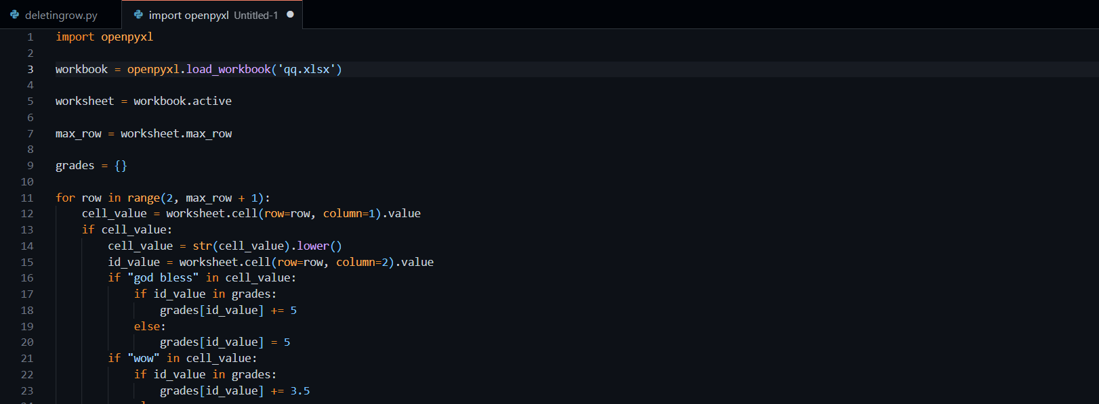
Python Code
Notes:
This is how we used python to grade the conversations with the grading criteria we made.
We loaded postquestion excel through openpyxl (that can efficiently manage the large amount of excel columns) and calculated each column based on the usage of keywords.

Slide 6
Part 2
Visualization of Analysis

Slide 7
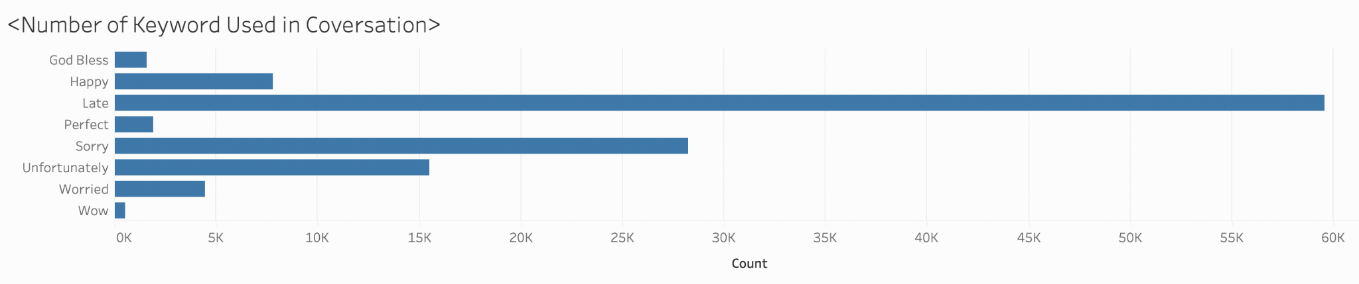
Number of Keyword Used in Conversation
Notes:
This is the some of our keywords that show rather the conversation is positive or negative. As the graph shows, the phrase 'God bless' is not the most frequent word used, but it is a very strong term that shows that the conversation went successful. On the other hand, the word 'late' is very frequently used, but it is sometimes negative and sometimes neutral. Like this, the frequency of language usage and its influence on the success or fail of the conversation varies. We tried to look at as many chats as possible so that we can make a trustworthy rubric on how much influence a specific word has on dialogue.

Slide 8
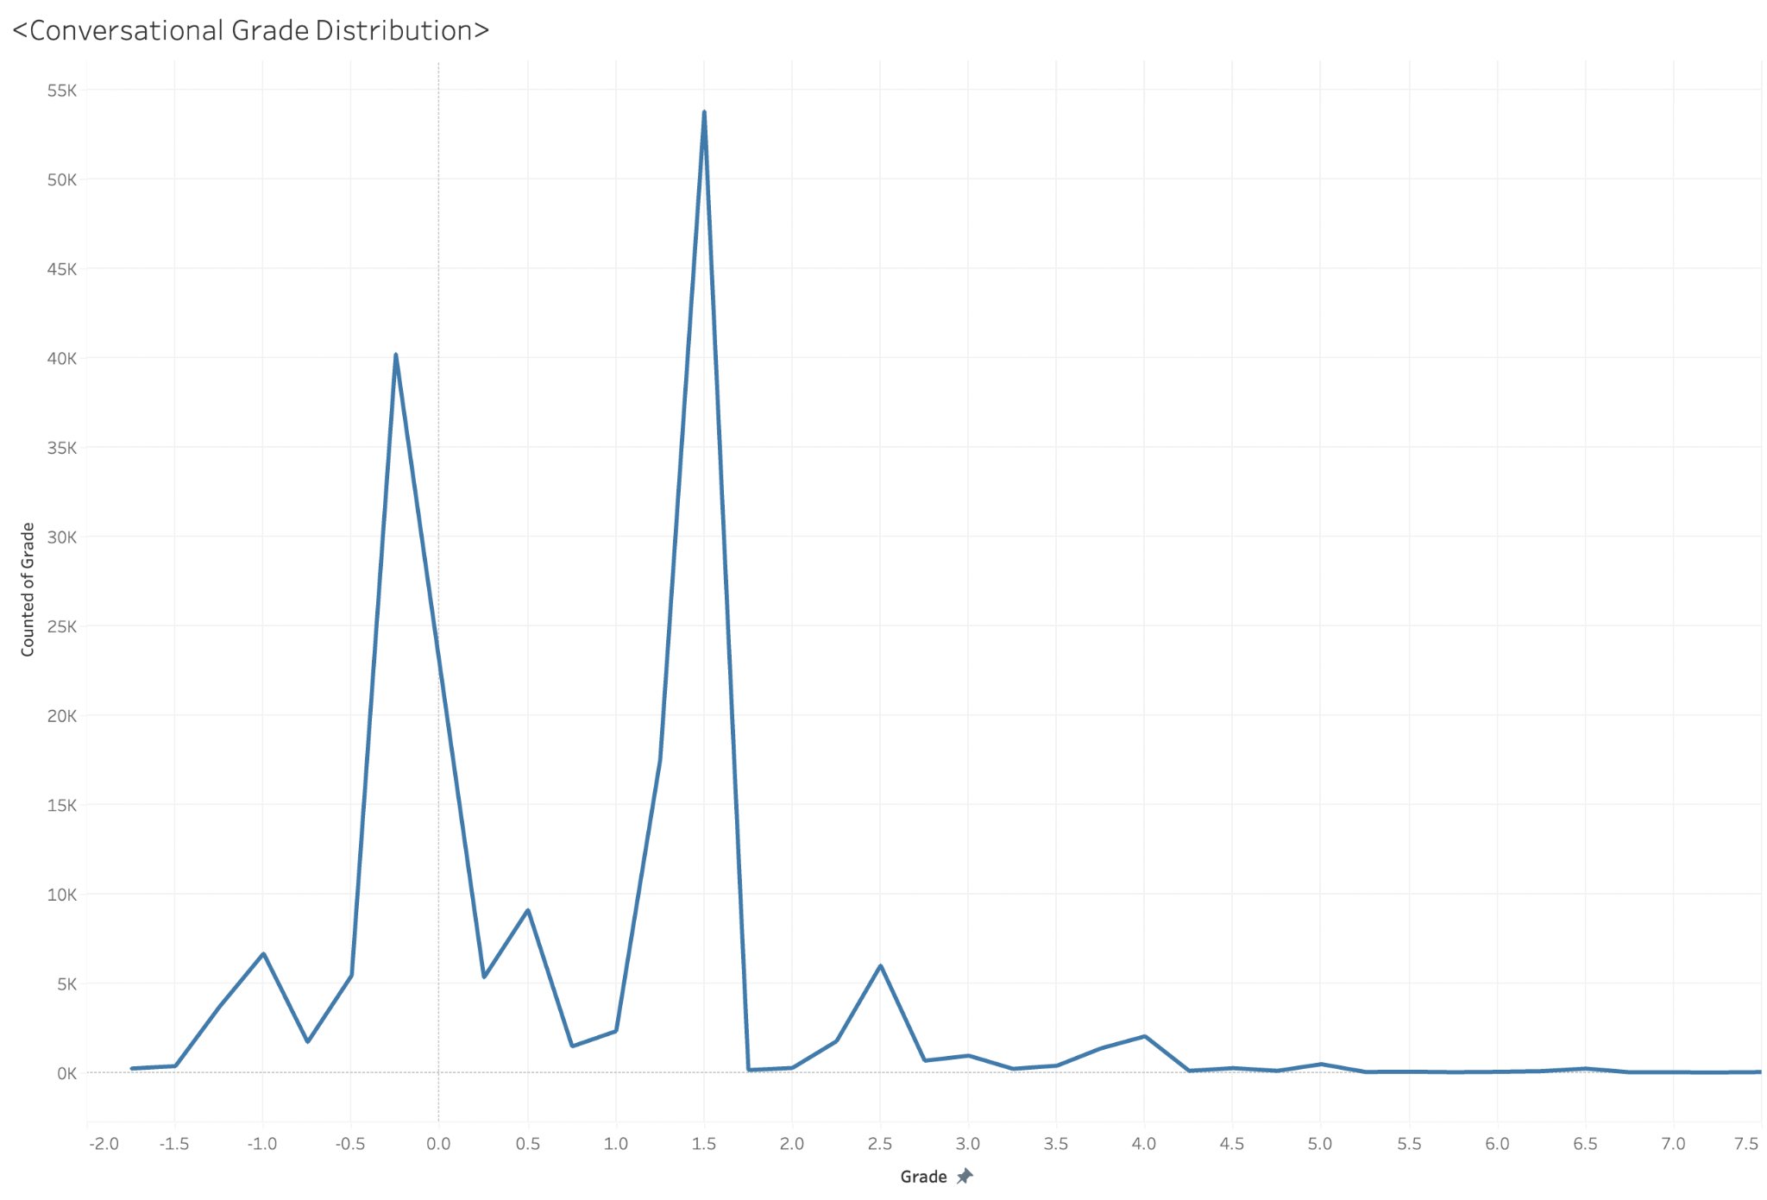
Conversational Grade Distribution
Notes:
This is our conversational grade distribution graph that shows how clients are spread based on their grades. The mode is at 1.5 and Dorian mode is at point 0.0. However, we decided not to concentrate too much on these cases as 0 means they did not use the positive or negative keyword or they canceled each other. For 1.5, we found out that most of them reached this score just by saying hi or thank you.
Therefore, we concentrated more on the highest and lowest-graded conversations.

Slide 9
Part 3
Finding Common factor of specific distribution of client
Notes:
Read

Slide 10
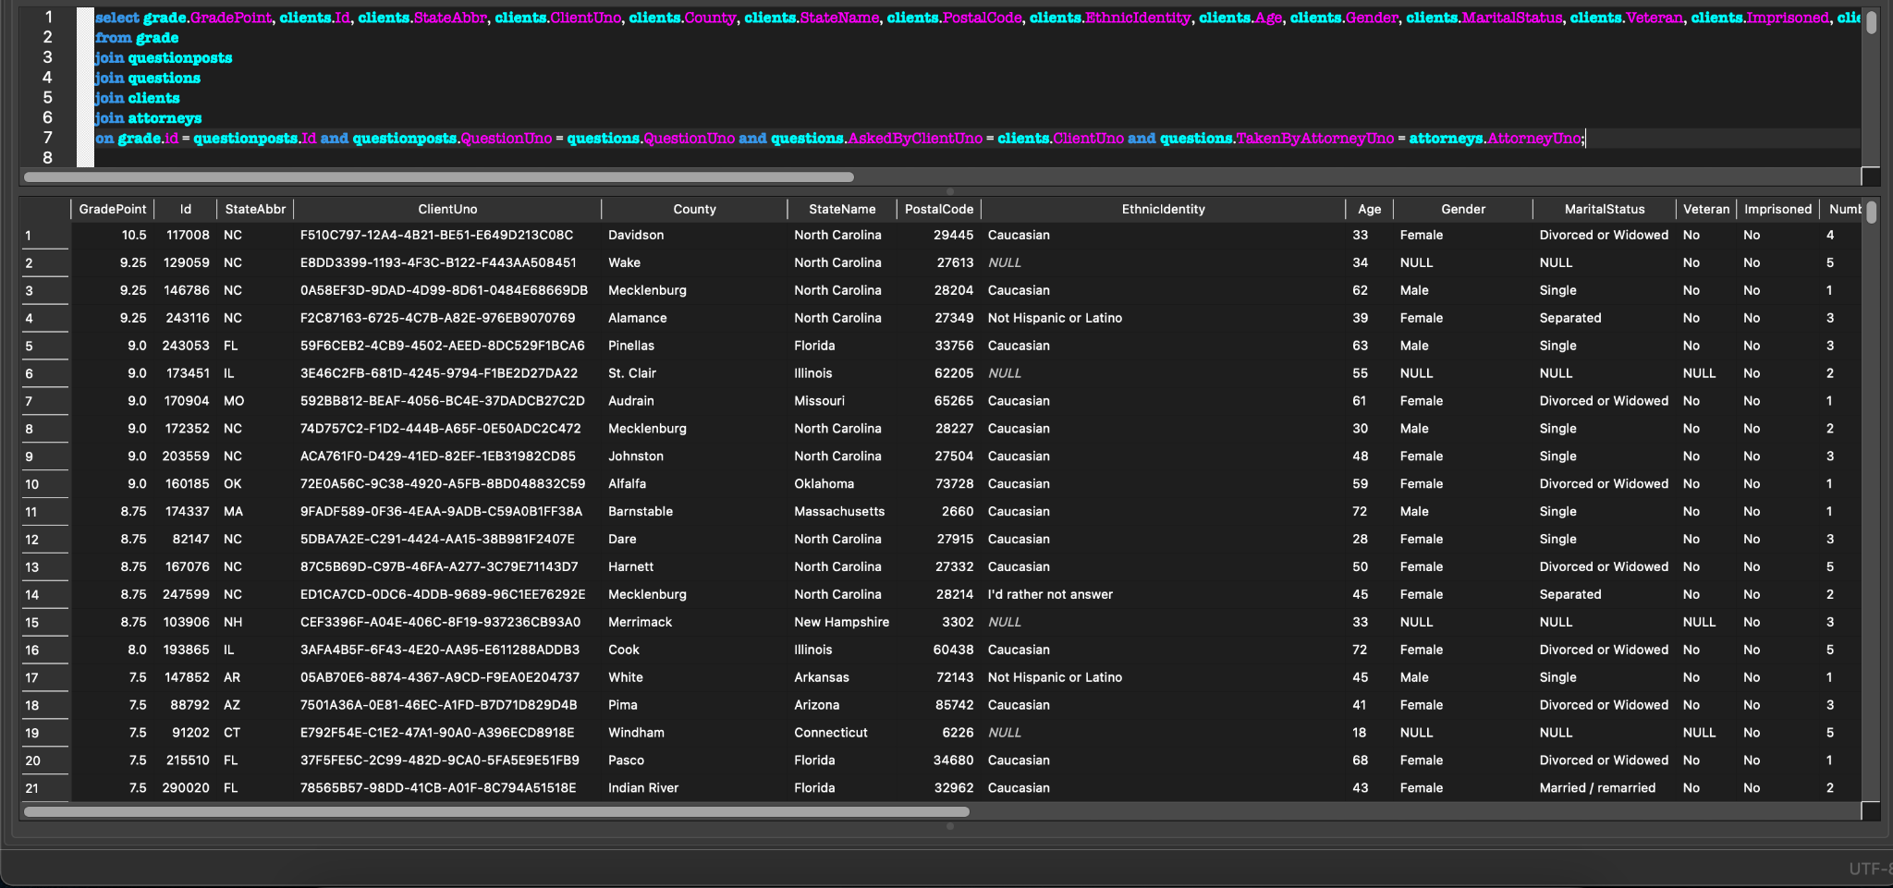
Identification of Clients and Attorneys

Slide 11
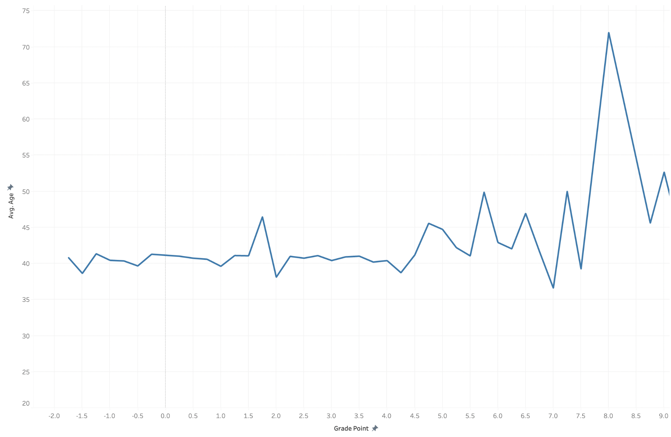
Common Factor - Age

Slide 12
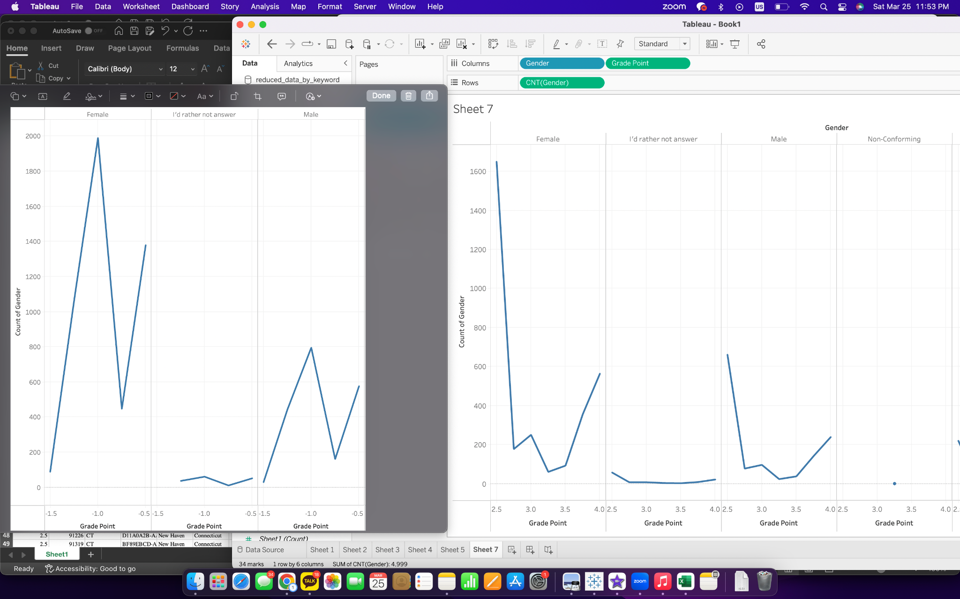
Common Factor - Gender

Slide 13
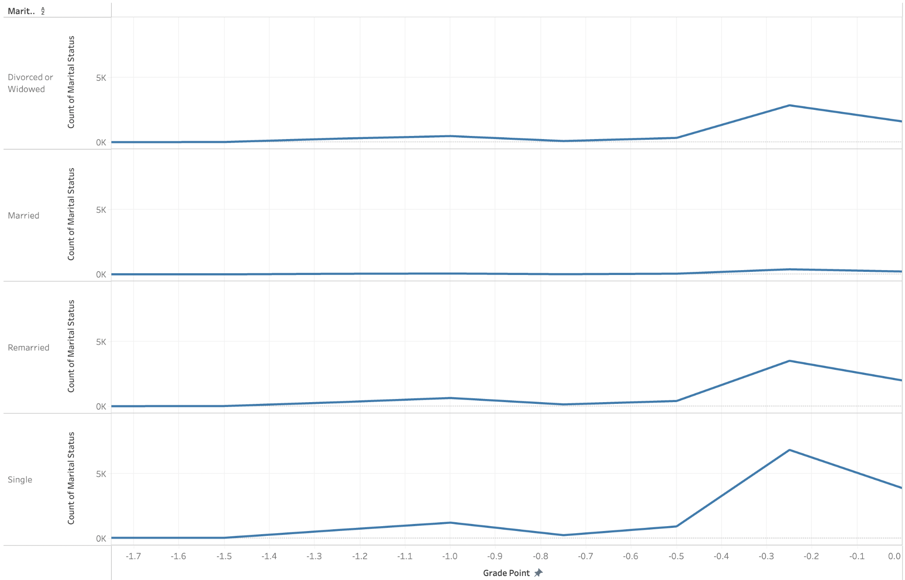
Common Factor - Marital Status

Slide 14
Part 4
Suggestion to improve
lawyer & client engagement

Slide 15
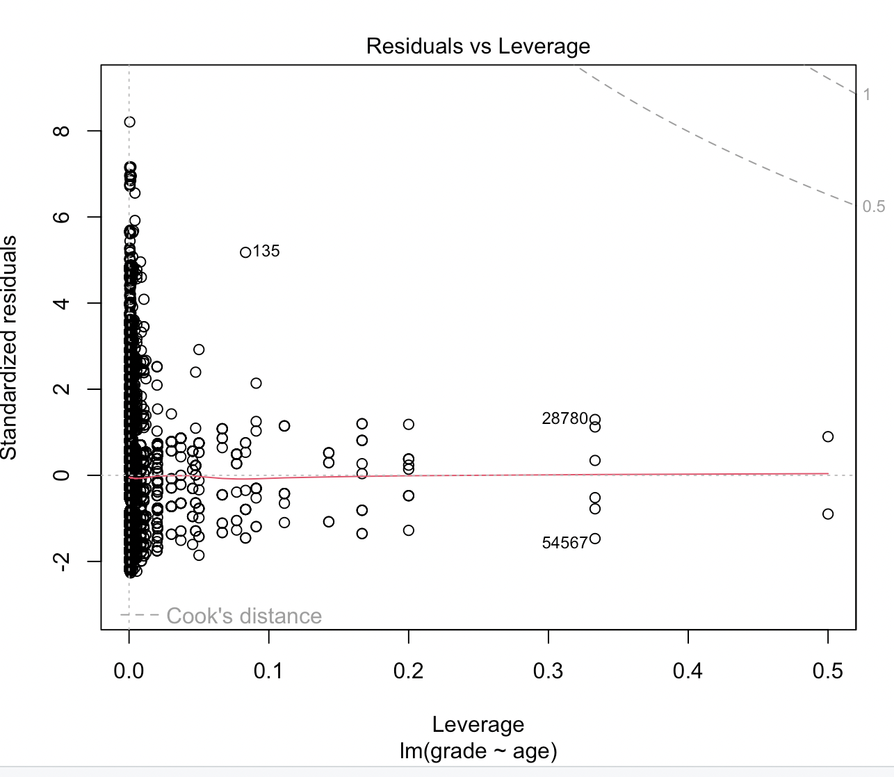
Limitation

Slide 16
Conclusion
Output : the group of below 40 years old single females tends to have more misleading conversations

Slide 17
General Chal
Thank You
Dongyeon Kang
Sunwoo Kim
Hoin Lee
Sungheon Lee
Jongmin Chung
General Chal
Notes:
Hello, we are team General Chal and we are going to analyze conversational data to find common factors among some specific clients and try to make a suggestion to improve lawyer-client engagement and legal services.

